Slide 1


Slide 2
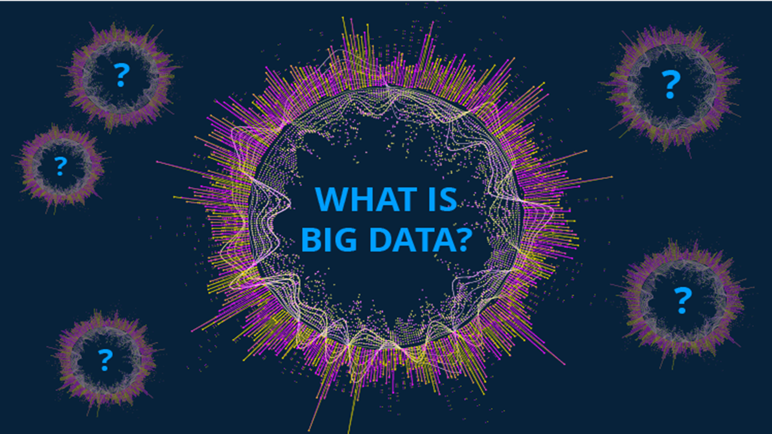

Slide 3
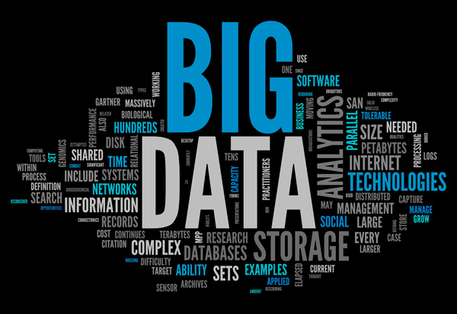

Slide 4

What is Big Data ?
Big data is a field that treats ways to analyze,systematically extract information from, or otherwise deal with datasets that are too large or complex to be dealt with by traditional data-processing application software

Slide 5
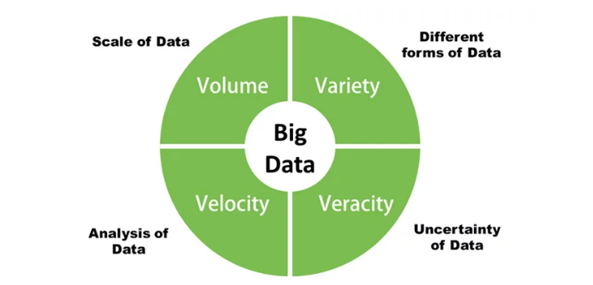

Slide 6
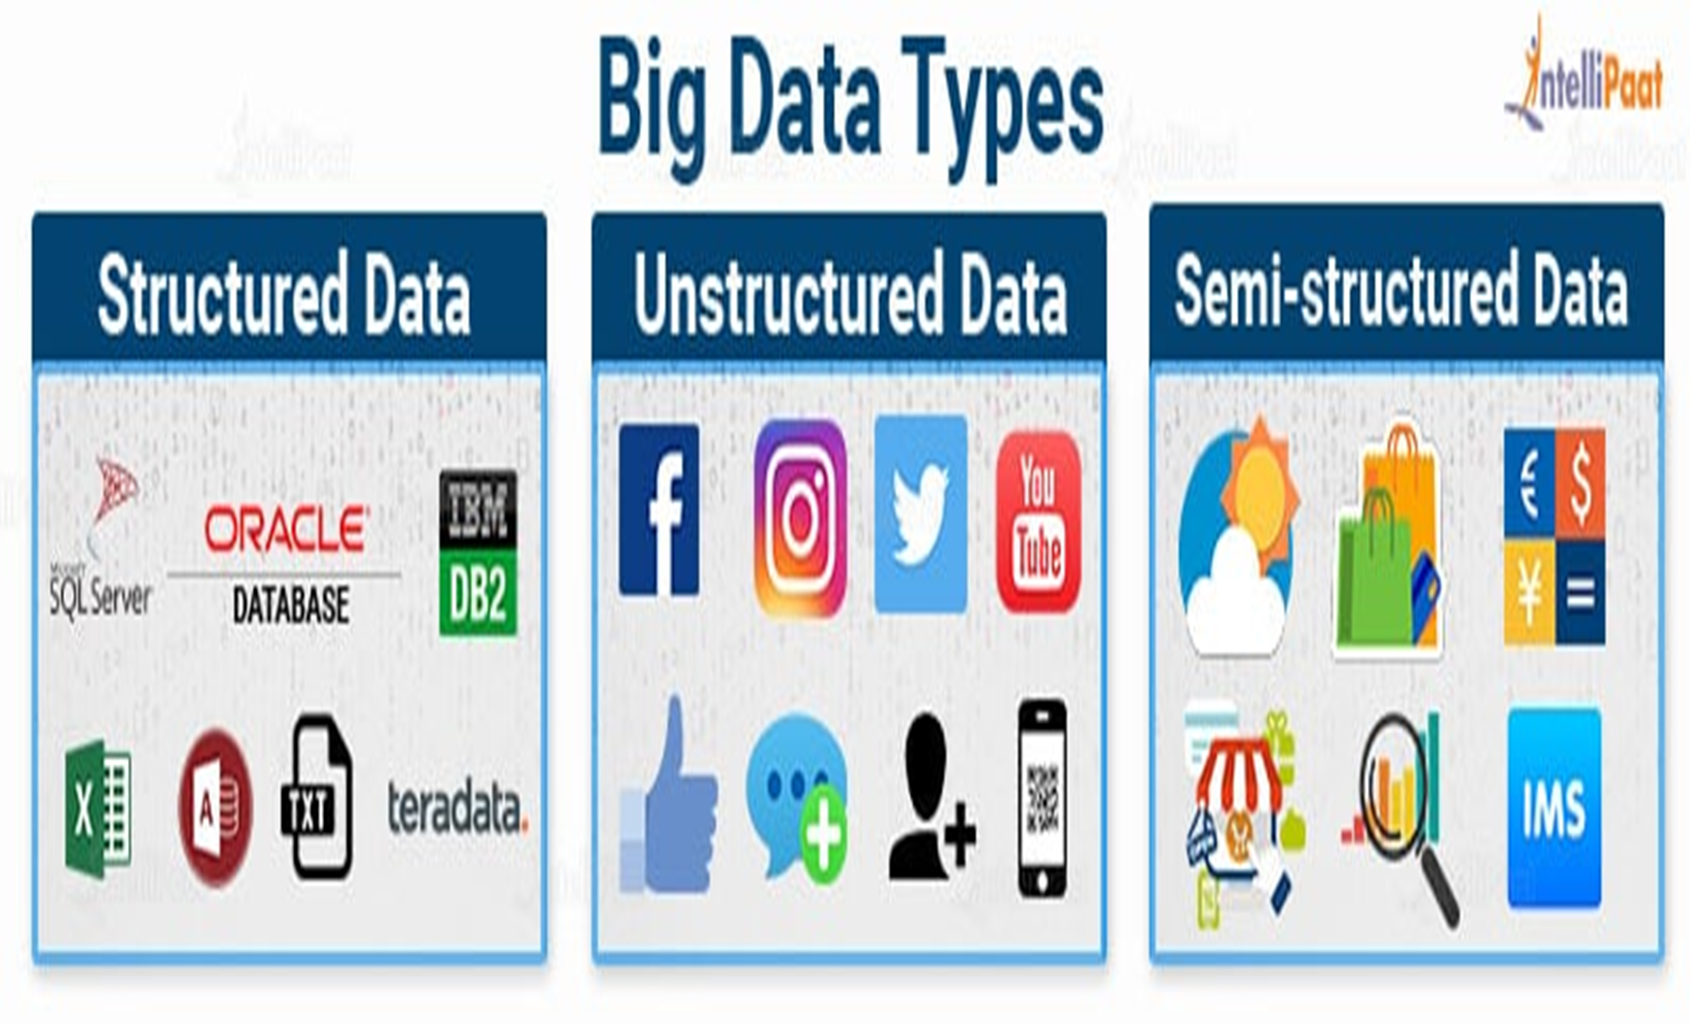

Slide 7
Structured data:
The term structured data generally refers to data that has a defined length and format for big data.
Examples: numbers, dates, and groups of words and numbers called strings
Unstructured data :
Unstructured Data in contrast, refers to data that doesn't fit neatly into the traditional row and column structure of relational databases.
Examples: emails, videos, audio files, web pages, and social media messages.

Slide 8
Semi-structured data:
Semi-structured data is the data which does not conforms to a data model but has some structure. It lacks a fixed or rigid schema.
It is the data that does not reside in a rational database but that have some organizational properties that make it easier to analyses.
Example:
CSV but XML and JSON documents are semi structured documents, NoSQL databases are considered as semi structured.

